Slide 1
Ageing and NCDs in the Caribbean
Ian Hambleton, The UWI
April 2025
Notes:
Overall idea is:
To highlight an aging of the Americas/Caribbean and how this demographic shift hampers our progress towards reducing the burden of NCDs
I’ll show the good news – the increasing Life Expectancy across the region
I’ll suggest that the usual way of presenting such data – averaged by region – masks a Caribbean stagnation
I’ll explore this stagnation by looking at the change in NCD disease burden over time
If time – I’ll summarise and suggest some avenues to consider – including introducing the CaribData project

Slide 2

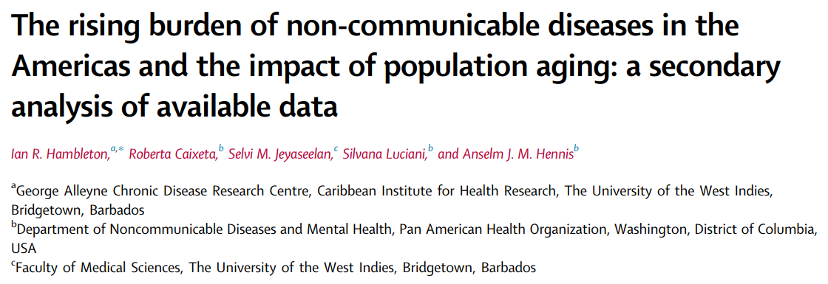
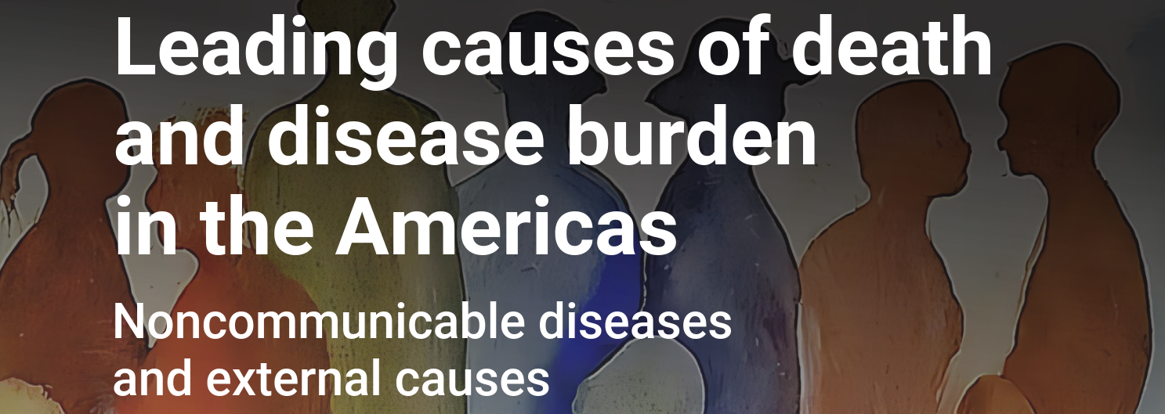


Notes:
Much of the analysis comes from these two CaribData publications – links to web resources at end of slides

Slide 3
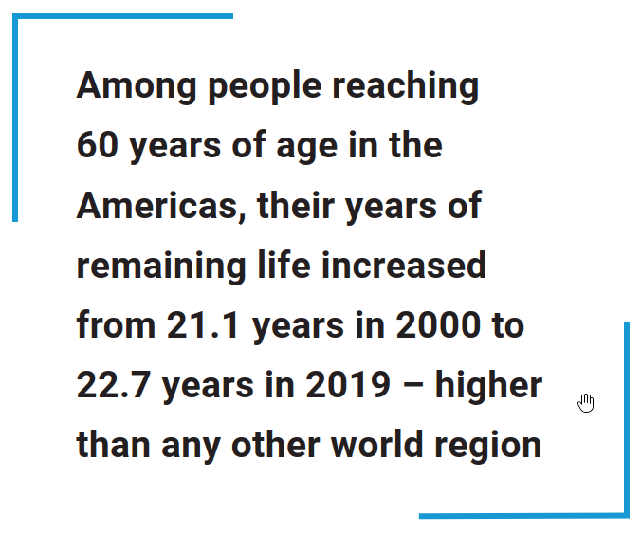
Aging in the Americas
5
In 2019 → Higher LE at 60
27
In 2019 → Lower LE at 60
Notes:
In an analysis for PAHO, we joined mortality data from the WHO with population data from the UN to explore life expectancy trends across the Americas. We focussed on the elderly and this was part of a wider review of aging and NCDs in the Americas.
And we saw that over the past 2 decades the years of remaining life for 60 year-olds in the Americas increased from 21 to almost 23 yrs – higher than any other world region. That sounds very positive, but regional averages as always will hide important evidence.
[SLIDE] When we compare Barbados to the regional average we start to wonder if something else is going on. The yrs of remaining life is still increasing, but at a much lower rate.
[SLIDE] And in fact – when we include every Caribbean country on this chart we see that 27 of the 32 Caribbean territories have a lower LE than the regional average, [SLIDE] with only 5 higher than the regional average.

Slide 4


The Barbados example. The country is ageing.
2000 | 2060
10% | 24%
7% | 22%
OLDER ADULTS
Population in Barbados (70+) has been growing fast, and this will continue.
COMPARED TO 2000
By 2060 elderly men expected to triple. Elderly women expected to more than double.
Notes:
By 2060
Number of elderly women expected to double
Number of elderly men expected to triple
Approaching ¼ of population

Slide 5
The effect on health - building our estimates (deaths)
Notes:
Play the slide…this is the change in deaths (DALYs – illness – shows a similar picture – see hidden slide at end)
What is the effect of this aging on national health
We’ve already seen the reduction in mortality due to mortality rates – that’s the blue line
That’s more than offset by the (35%) increase in deaths due to aging - orange
And the (6%) increase in deaths due to population growth (purple line)
So that between 2000 and 2020, there was a 32% increase in deaths
Other Caribbean countries have a similar pattern
We’re fighting a tide of aging, and our public health improvements need to be much greater if we’re to offset this tide.

Slide 6
Summarising
Barbados
32%
DEATHS → 32% INCREASE
Public health progress on its own
7% fewer deaths
deaths from aging up by 35%
deaths from growth up by 6%
Demographic pressures more than offset any healthcare gains
Game-changing healthcare implications…
Notes:
A reminder of the key result
And we see the same story if we use DISABILITY (DALYs) instead of deaths

Slide 7
Summarising
Notes:
The previous slides didn’t think about the changing causes of deaths (or ill-health if we think about DALYs)
→ Just showing top 5 / bottom 4 → Here is a slide of how mortality rates have changed over 20 years
→ Lower death rates from heart attacks and strokes
Higher death rates from falls, from dementias, and from drug use (opioid in the USA, Canada drive this)
Death rates don’t mean a drop in number of deaths
But it hints at how the profile of deaths will change over time
Relatively more dementia deaths over time

Slide 8
The Successes
Lower illness/death rates
Lower IHD, Stroke. Higher dementias, falls.
Higher Life Expectancy
Median age rising from 22.6 (1980) → 37.6 (2060)
Public health
Achievements in (e.g.) infectious diseases, managing NCDs, enabling healthy living
Social Improvements
Broader social development. (e.g.) health spending, healthier living, income per capita, education.
All good! The next challenges…

Slide 9
The Challenges
Longer Lives
Healthy aging or long-term multimorbidity…?
Universal Health Coverage
Healthy aging / avoiding risk factors. Aspirational?
Dependency Ratio
Old age DR → 12 in 2020. Up to 29 by 2060. Affordability of UHC / healthy aging.?
Multimorbidity
More – and more complex – healthcare demand.

Slide 10
Broad actions
Social Improvements
Health spending, healthier living, income per capita, education, community health. I.E. All of Society approach…
Foresight scenarios
Common in climate change. Uncommon in health.
Monitoring
Major improvements in data availability / accessibility – E.G. CaribData…

Slide 11





CaribData ● Data for Impact
Building
Infrastructure
Developing
training and guidelines
Analytics &
Communication
Establishing networks for collaborative working
Notes:
What we know if that there’s a lot we don’t know. The Caribbean has the lowest level of health data availability and accessibility in the world. And I just want to mention a project we’ve started with IDB to help with this problem. Called CaribData, its
And broadly. We’re building a set of resources to enable and encourage Caribbean data sharing and data re-use.
[SLIDE]. We’re setting up an online infrastructure to enable easier data collection, data sharing and re-use.
[SLIDE]. We’re developing a training program and longer-term mentoring to increase capacity in data handling and data communication.
[SLIDE]. We’re developing a data communications web platform. This is all about actively communicating the stories around the data we all produce. And at the same time, advocating for data re-use.
[SLIDE]. And we’re actively training data stakeholders, and building collaborations to develop a sustainable team of data storytellers.

Slide 12


CaribData
Collective data sharing
CaribData
Infrastructure
●
Training
●
Storytelling
Collective Impact
Notes:
Right now in the Caribbean, I think it’s fair to say that much of our data landscape sits somewhere between disorder and confusion and individual impact.
We have brilliant people and powerful data, but it's often siloed, fragmented, and hard to access. And while there are pockets of excellence, they often operate in isolation, with limited reach or long-term influence.
So the vision for CaribData is to create a shared culture of evidence in the Caribbean, where data moves from confusion to collaboration

Slide 13
Reports available online
doi.org/10.1016/j.lana.2023.100483
www.paho.org/pub/en/leading-causes-death-disease-burden-americas/

Slide 14
Gender Data Availability
SA: 68%
EAP: 60%
NA: 58%
SIDS: 35%
Notes:
→ This slide explains why we need CaribData
Shows data availability in the SIDS compared to other global regions
Gender data as an example
1/3 data availability in the SIDS, compared to generally 2/3 and higher in the rest of the worls.
In many areas of endeavour, including health, we don’t know what we don’t know…

