Slide 1
CaribData: An ecosystem for data resilience
An initiative to encourage and enable data sharing
CaribData team
January 2025

Slide 2
Our experience with data in the Caribbean…
Data handling in this fast-moving field is increasingly complex
Move toward big-data
Data now mostly collected online
Collection often automated
Associated analytics increasingly complex
Fast-changing regulatory environments
E.G.
Barbados Data Protection Act (2019)
Jamaica Data Protection Act (2020)
GOAL: Helping data professionals keep up with best-practice data handling

Slide 3
Our experience with data in the Caribbean…
Data handling in this fast-moving field is increasingly complex
Useful data are:
Well-documented
Easily available
Data wastage from poor data-handling
“Improve data-handling and data-handling infrastructures” (Lancet, 2016)
Data graveyards
Data without best-practice data handling is regularly unusable
GOAL: Reducing data wastage

Slide 4
Our experience with data in the Caribbean…
Data handling in this fast-moving field is increasingly complex
International collaborations common
‘Centre-of-gravity’ important
But many projects now use overseas data infrastructures
Critical risk to regional data sovereignty
Goal is to provide a Caribbean solution for data handling and secondary data analysis
Data without best-practice data handling is regularly unusable
Small Island Developing States - the need for data sovereignty
GOAL: A regional option for maintaining data resources

Slide 5
Our experience with data in the Caribbean…
Data handling in this fast-moving field is increasingly complex
World Bank (2022)
Statistical Performance Indicators.
Data without best-practice data handling is regularly unusable
Small Island Developing States - the need for data sovereignty
Data availability and accessibility in the Caribbean is limited
GOAL: Improving data availability and accessibility

Slide 6



Slide 7
SDG Data Availability
LA: 87%
SSA: 78%
MENA: 71%
SIDS: 64%

Slide 8
Gender Data Availability
SA: 68%
EAP: 60%
NA: 58%
SIDS: 35%

Slide 9




To enable & encourage Caribbean data sharing / re-use
We aim to do this by
Storytelling
Infrastructure
Online software • Data Entry (REDCap) • Data Sharing (Zenodo)
Data
Communication
Data storytelling platform • Storytelling training • Storython
Gap Analyses
and Guidelines
Legislative landscape for sharing • Online data handling guides
Networks for
Collaborative Storytelling
Develop cohort of data producers & storytellers.

Slide 10
Thank-you!
CaribData team
January 2025

Slide 11
Extra Slides

Slide 12
Lessons learnt so far
Grow organically (see RedCap)
Identify and engage early adopters (e.g. Belize, Guyana)
Agility is key given the field…
Centralized support is the eventual ideal and the only likely route to wide uptake
(econ. of scale)
Encourage feasibility work during proposal development
Broader retooling of wider public sector administration

Slide 13
Statistical capacity and population size

Slide 14
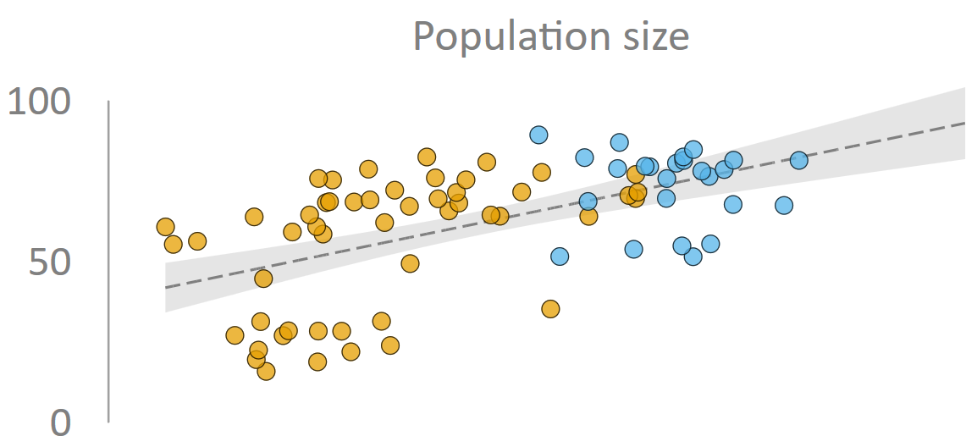


Statistical capacity and population size

