Slide 1
Ageing and NCDs in Barbados
Ian Hambleton, The UWI
September 2024

Slide 2

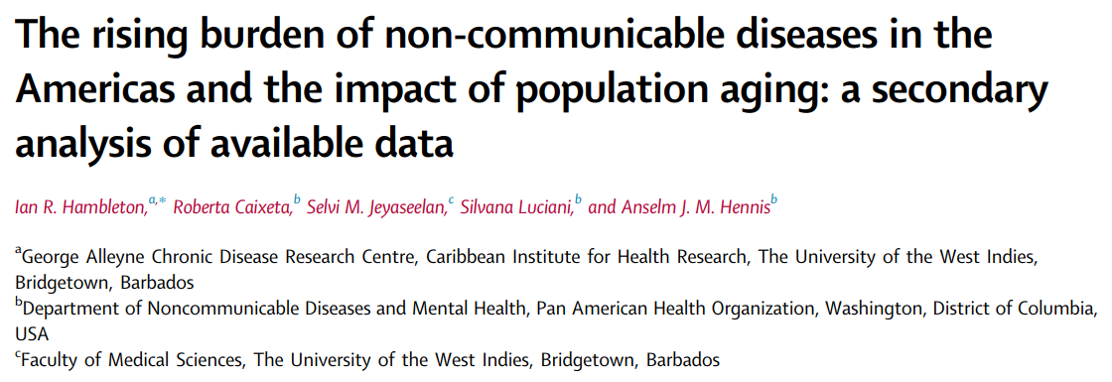
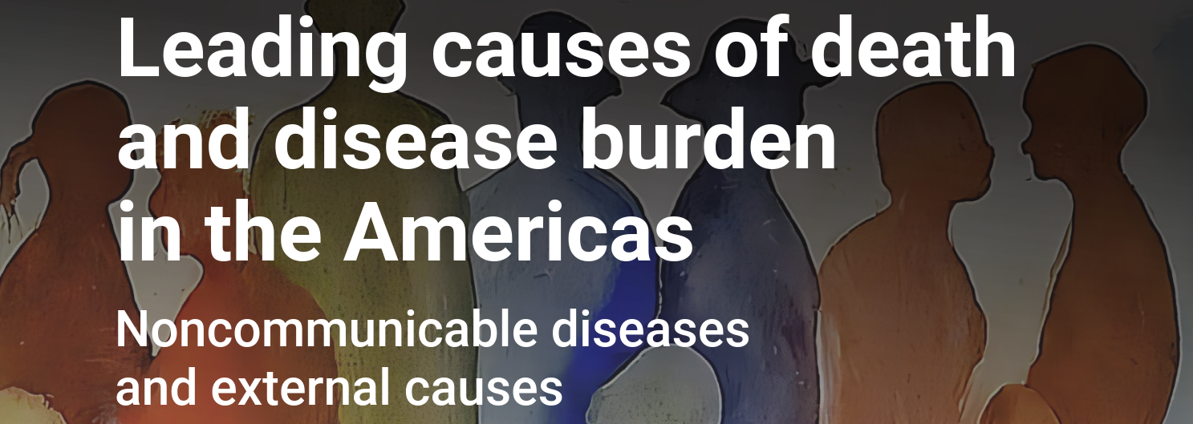



Slide 3


Life expectancy is increasing.
 | 2000 | 2019
GLOBAL | 66.8 | 73.3
AMERICAS | 74.1 | 77.2
Barbados | 74.5 | 76.0
 | 77.1 | 79.8
 | 71.1 | 74.5

Slide 4
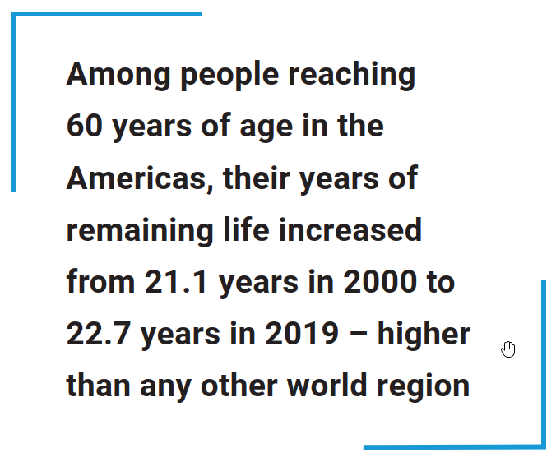
Life expectancy is increasing… But not always.

Slide 5




What might be causing this stagnation?
Our Data
We joined two datasets:
WHO data on annual deaths and illness
UN population data
Our Methods
For 33 countries, we compared deaths/illness in 2000 and in 2019
We split the change into THREE explanations:
Due to public health advances
Due to population growth
Due to population ageing

Slide 6
The Barbados analysis. Public health advances.
2000 | 2019
448 | 431
562 | 533
SINCE 2000
The Barbados health system has presided over a reduction in death rates due to NCDs.

Slide 7


The Barbados analysis. The country is ageing.
2000 | 2019
14k | 19k
9.5k | 14.5k
OLDER ADULTS
Population in Barbados (70+) has been growing fast, and this will continue.
COMPARED TO 2000
In 2020 there were almost 5,000 more elderly women and another 5,000 more elderly men living on the island.

Slide 8
The Barbados analysis. The country is ageing.
2000 | 2060
10% | 24%
7% | 22%
OLDER ADULTS
Population in Barbados (70+) has been growing fast, and this will continue.
COMPARED TO 2000
By 2060 elderly men expected to triple. Elderly women expected to more than double.

Slide 9
The effect on illness - building our estimates

Slide 10
Summarising
DISABILITY → 28% INCREASE
Public health progress on its own
5% fewer years of illness
Illness from aging up by 27%
Illness from growth up by 6%
DEATHS → 35% INCREASE
Public health progress on its own
8% fewer deaths
Deaths from aging up by 35%
Deaths from growth up by 6%
Demographic pressures more than offset any healthcare gains
Game-changing healthcare implications…

Slide 11
Some Areas for Discussion…

Slide 12
The Successes
Lower illness/death rates
Lower IHD, Stroke. Higher dementias, falls.
Higher Life Expectancy
Median age rising from 22.6 (1980) → 37.6 (2060)
Public health
Achievements in (e.g.) infectious diseases, managing NCDs, enabling healthy living
Social Improvements
Broader social development. (e.g.) health spending, healthier living, income per capita, education.
All good! The next challenges…

Slide 13
The Challenges
Longer Lives
Healthy aging or long-term multimorbidity…?
Universal Health Coverage
Healthy aging / avoiding risk factors. Aspirational?
Dependency Ratio
Old age DR → 12 in 2020. Up to 29 by 2060. Affordability of UHC / healthy aging.?
Multimorbidity
More – and more complex – healthcare demand.

Slide 14
Broad actions
Social Improvements
Health spending, healthier living, income per capita, education, community health. I.E. All of Society approach…
Foresight scenarios
Common in climate change. Uncommon in health.
Monitoring
Major improvements in data availability / accessibility – E.G. CaribData…

Slide 15
Gender Data Availability
SA: 68%
EAP: 60%
NA: 58%
SIDS: 35%

Slide 16
Reports available online
doi.org/10.1016/j.lana.2023.100483
www.paho.org/pub/en/leading-causes-death-disease-burden-americas/

Slide 17
Slide template

Slide 18
Mortality rates are decreasing
DEATH RATE
DALY RATE
ALL CVD
ALL CANCERS
RESPIRATORY
DIABETES
Notes:
And LE continues to increase because over the past 20 years we’ve seen some quite dramatic falls in mortality rates for the major chronic conditions.
For CVD in particular, age-standardized mortality rates and disability rates are down by around a third since 2000.
Now AGE-STANDARDIZED RATES allow us to compare the health of different countries, and health over time. It’s like taking
----
So this is all good news, but before we all cheer too loudly and nip home for doughnut, we now need to consider the obvious result of this.
If we’re all living longer lives, what happens to us as we reach our aspirational older ages…

Slide 19
Building our estimates
Notes:
We can imagine what this will mean for the health system.
Those public health advances between 2000 and 2019 I mentioned would have led to a 7% drop in deaths.
But – the aging population created a 35% increase in deaths
And population growth led to a 6% increase in deaths
So – overall – we saw a 32% increase in deaths.
We fighting a tide of aging, and our public health improvements need to be much greater if we’re to offset this tide.

