Slide 1
CaribData: An ecosystem for Caribbean data-driven resilience
Welcome (IH & KG, 5 mins)
Brief introductions (ALL, 5 mins)
Appointment of Committee Chair and Vice-Chair (GV, 5 mins)
Project goals and project Terms of Reference (IH, 15 mins)
Open Discussion (ALL, 20 mins)
Next Steps (GV, 5 mins)
Meeting Close (IH)

Slide 2
CaribData: An ecosystem for Caribbean data-driven resilience
Ian Hambleton, The UWI
2 May 2023

Slide 3

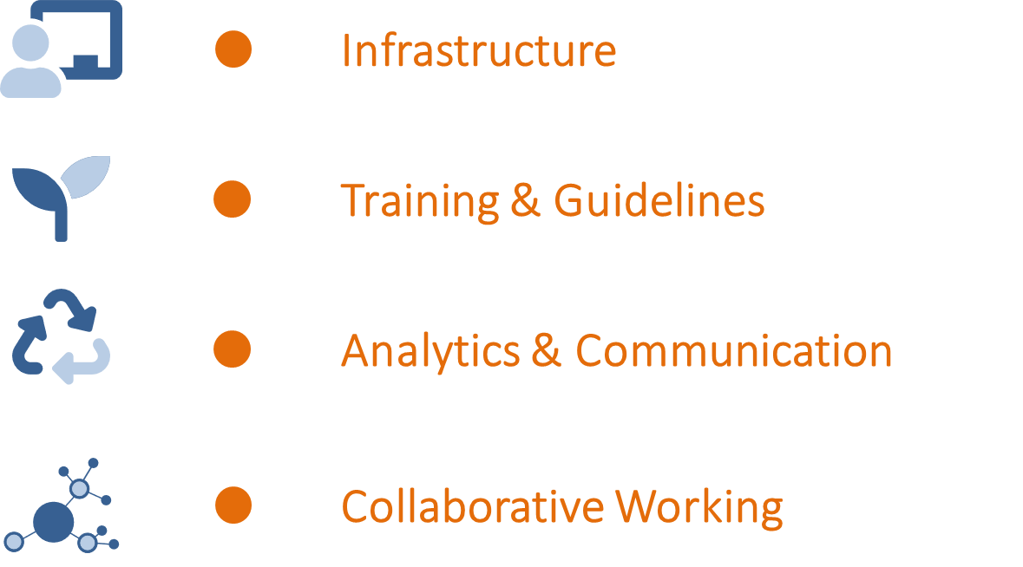
CaribData
An ecosystem for Caribbean data-driven resilience

Slide 4





To enable & champion Caribbean data sharing / re-use
We aim to do this by
Building
Infrastructure
Online software • Data Entry •
Data Sharing
Developing
training and guidelines
Workshops • Online learning •
Longer-term mentoring
Analytics &
Communication
Analytics for Caribbean evidence •
Data stories • Datathon
Establishing networks for collaborative working
Conferencing and workshops.
Cross-sector collaborations.

Slide 5
Our Philosophy
  A network to enable Caribbean data re-use
  Complement other regional data initiatives
  Support country partners according to their level of data development
A focus on sustainability
Country partners
● National Statistical Offices
●Ministries of Health & Env.
● NGOs ● Civil Society
Regional partners
● The UWI ● IDB
● PAHO ● CDEMA

Slide 6
The Work Packages
Establishing networks for collaborative working
Policy Environment
Data policy review
Data Policy development
Data Environment
Data Audits
Data Collation
Data Curation

Slide 7
The Work Packages
Building
Infrastructure
CaribData Portal
Data collection platform
Data sharing platform
Data Stories website
  Caribdata.org

Slide 8
The Work Packages
Developing
training and guidelines
Data Training
Understand NSO needs
Data Science short courses
Ongoing mentoring program
Online self-paced learning
Best-practice data guidelines
Data Communication
Caribbean data stories
Mixed online feeds
Data Journal
Data conference
Sustainability framework.
Analytics &
Communication

Slide 9
Questions & Discussion
  What do you hope to get out of this project?
  What are your key data needs?
    Infrastructure
    Training
    Additional resources in any particular area?
  Are we broadly happy with the project Work Packages / ToRs?

