Slide 1
COVID-19 regional surveillance / data resilience
Ian Hambleton, The UWI
08 December 2022

Slide 2
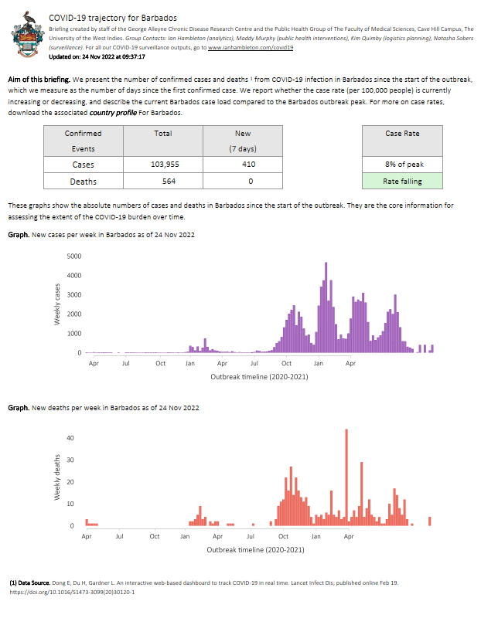
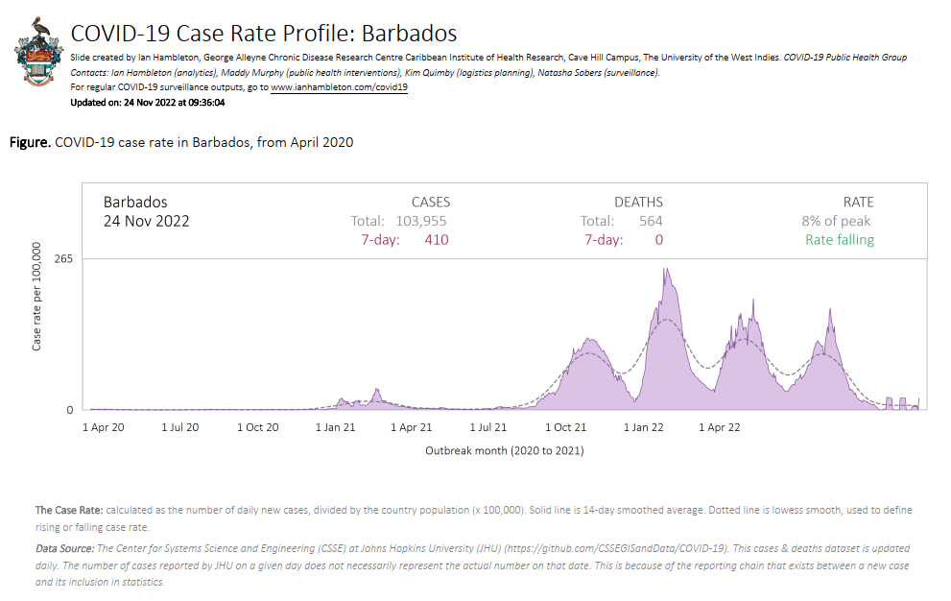
Daily surveillance: Country reports online each morning
20 country briefings: 14 CARICOM and 6 UKOTS
bit.ly/uwi-covid19

Slide 3
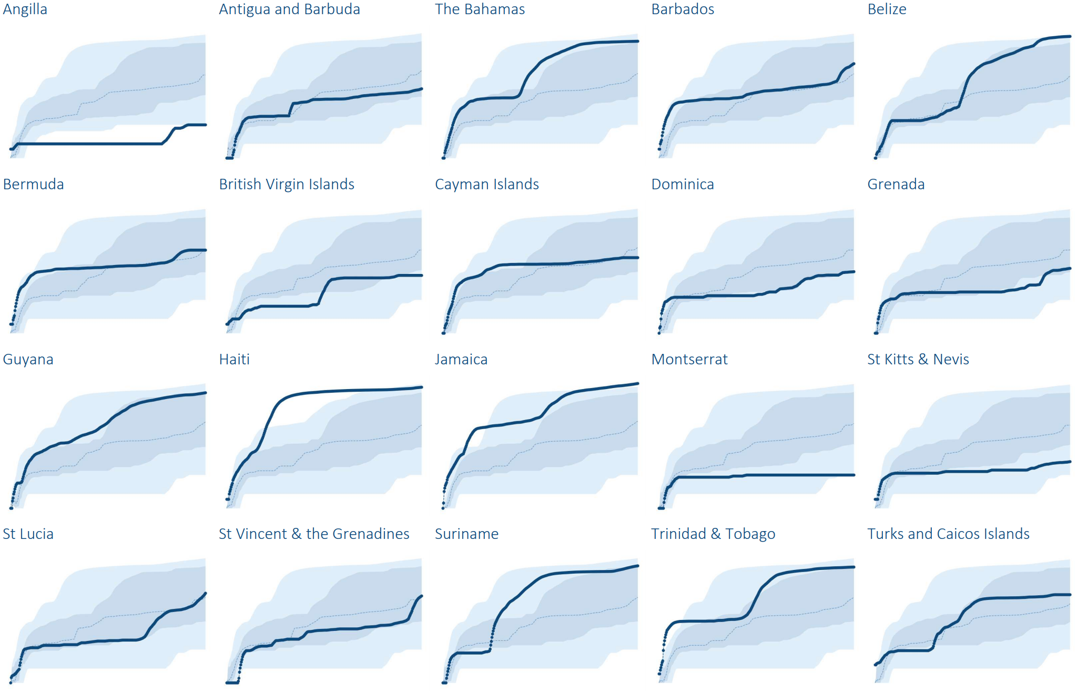
Daily surveillance: outbreak growth

Slide 4
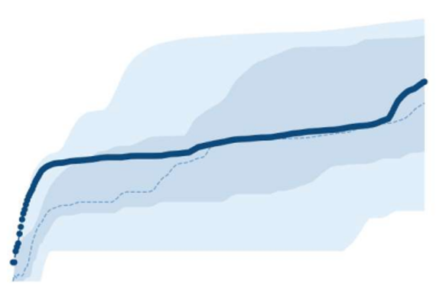
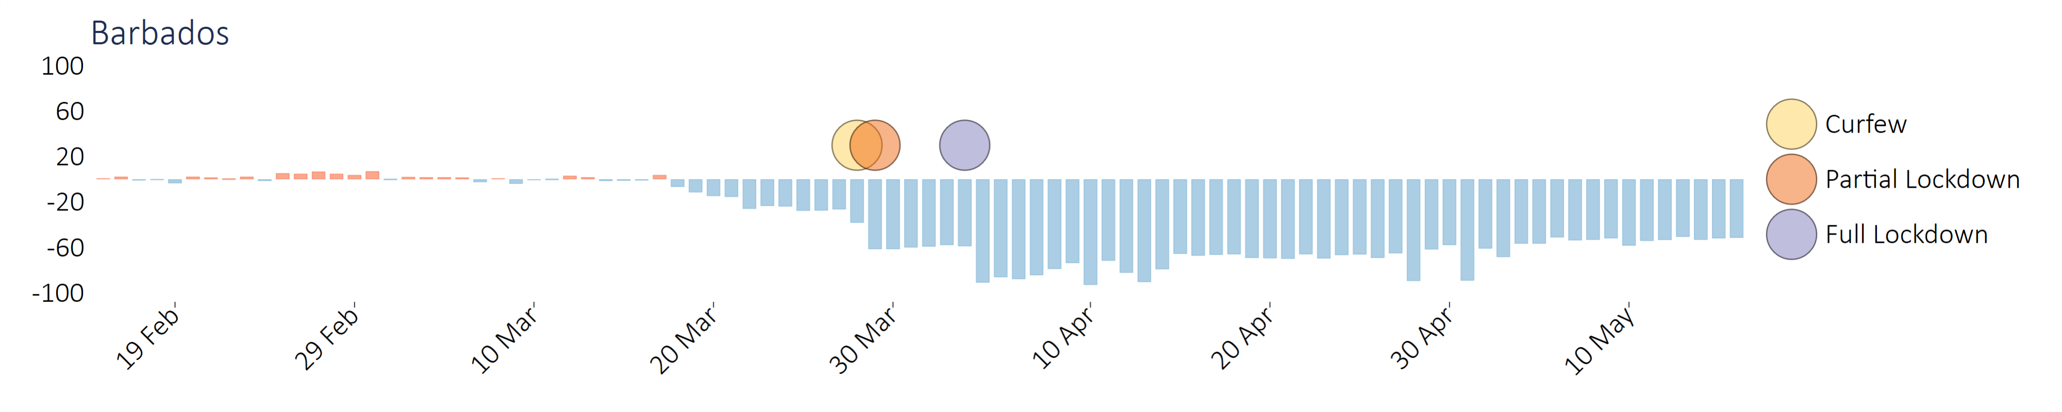
Daily surveillance: government response

Slide 5
Daily surveillance: current situation - regional
 | This week | Last week | 2 weeks ago
CASES | 801 | 511 | 727
DEATHS | 56 | 13 | 34

Slide 6
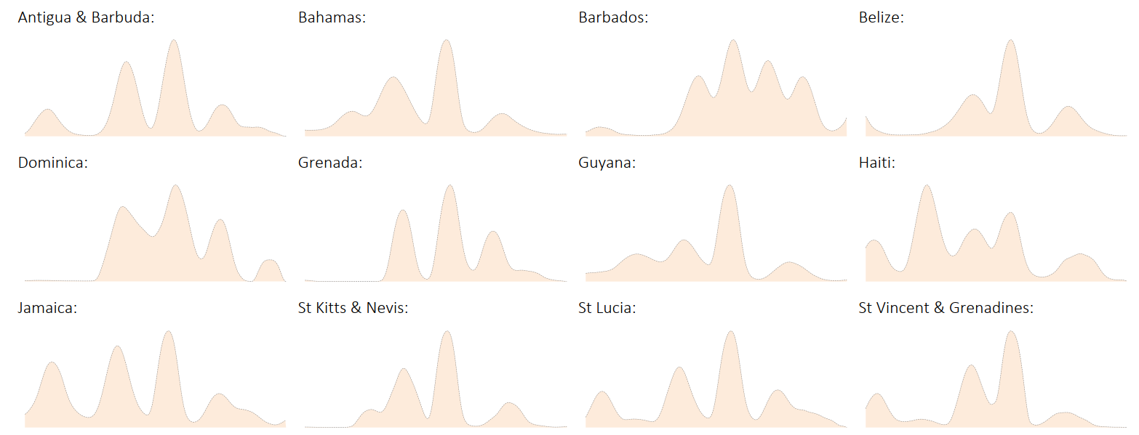
Daily surveillance: current situation - country

Slide 7
Daily surveillance: Data availability
Needed
Excess Mortality

Slide 8
Data availability and accessibility in the Caribbean is limited
World Bank (2019)
Data for SDG Reporting.

Slide 9
Daily surveillance: Data challenges
Need Standards for data
Overall
Need Standards for reporting
Need permanent archiving
Data Permanence
Need record of changes
Need accessible file formats
Data Elements
Need data coding standards
Clearly describe missing data / data lags
Epi Challenges
Need describe case definition

Slide 10

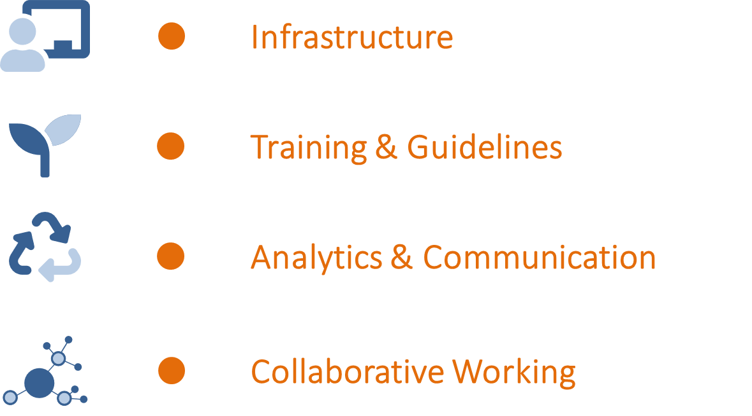
CaribData
An ecosystem for Caribbean data-driven resilience

Slide 11





To enable & champion Caribbean data sharing / re-use
We aim to do this by
Building
Infrastructure
Online software • Data Entry •
Data Sharing
Developing
training and guidelines
Workshops • Online learning •
Longer-term mentoring
Analytics &
Communication
Analytics for Caribbean evidence •
Data stories • Datathon
Establishing networks for collaborative working
Conferencing and workshops.
Cross-sector collaborations.

Slide 12
Regional partners
Country partners
The UWI
IDB
PAHO
CDEMA
National Statistical Offices
Ministries of Health & Env.
NGOs / Civil Society
  A network to enable Caribbean data re-use
  Focus on sustainability
  Complement other regional data initiatives
  Support country partners according to their level of data development

Slide 13
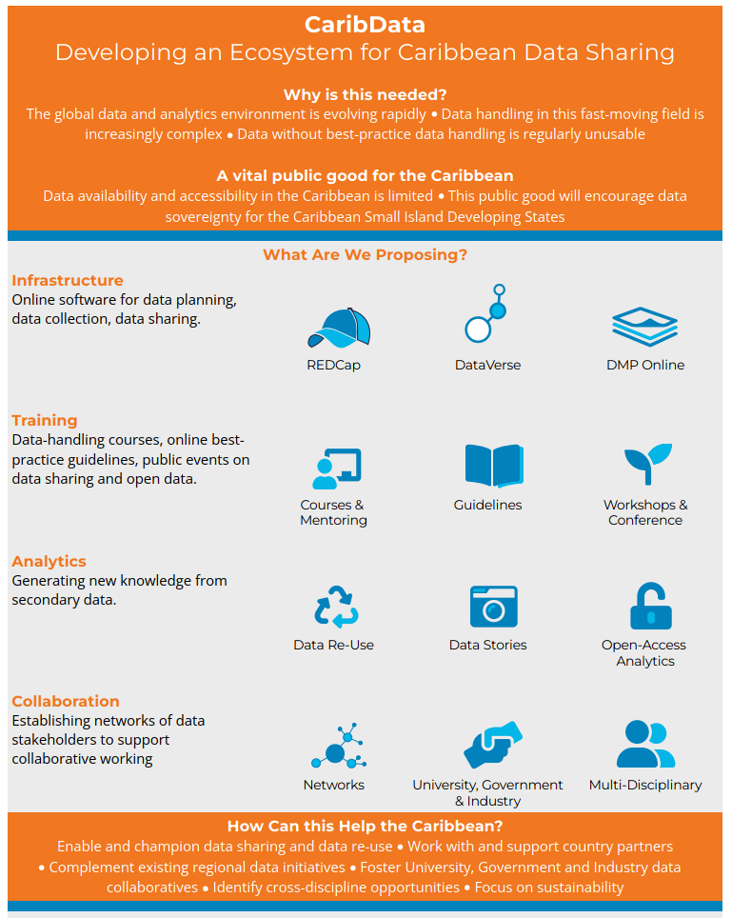
bit.ly/CaribData

